Slide 1

Change this Image (relevant to webinar)
The Agile way with PMI® ACP?

Slide 2





What will you learn today?
Let us have a quick poll, do you know the following topics?
Agile Philosophy & Principles
About PMI-ACP Exam
How PMI-ACP® certification will help?
Eligibility Requirements for the Exam
Application Process

Slide 3
Central Challenge!
Are we “Building Right Things”?
Are we “Building Things Right”?

Slide 4
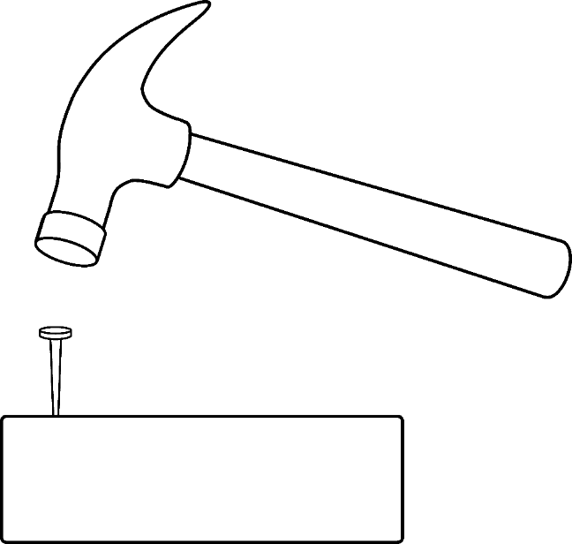
Central Challenge!
“With a hammer in hand every problem looks like a nail…”
“Tools” Mentality
vs.
“Problem Solving” Mentality

Slide 5
Agile Philosophy & Principles

Slide 6
Agile Philosophy
Individuals and interactions over processes and tools
Working software over comprehensive documentation
Customer collaboration over contract negotiation
Responding to change over following a plan
Courtesy: http://www.agilemanifesto.org/

Slide 7
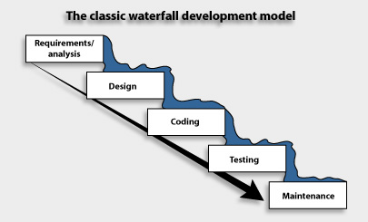
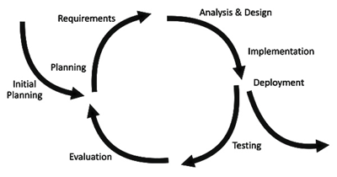
Agile Principles
Classic Waterfall
Iterative Development
Tries to eliminate uncertainty by planning upfront.
Embraces uncertainty with short iterations.
Consequence: Inspect and Adapt.

Slide 8
About PMI-ACP® Exam

Slide 9
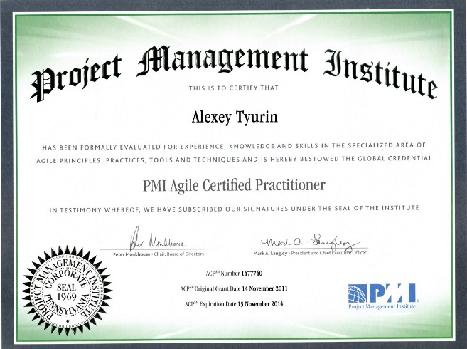
About PMI-ACP® Exam
PMI-ACP® exam is based on:
12 recommended books from PMI® known as “Reference Materials” (https://www.pmi.org/~/media/PDF/Certifications/ACP_Reference_list_v2.ashx)
Once certified, the ACP certification is valid for 3 years
To continue to hold the PMI-ACP® certification, at the end of the 3 year certification cycle, one needs 30 PDU’s
PDU stands for Professional Development Unit
1 PDU corresponds to 1 hour of professional development activity

Slide 10
How will PMI-ACP®
Certification Help?

Slide 11
How will PMI-ACP® Certification Help?
Certified Agile Practitioner will be able to:
Understand the various aspects of implementing Agile in the organization
Give structure to Agile body of knowledge to meet their needs
Handle Agile Projects more effectively
Build on the confidence of customers
More Rigour

Slide 12
Eligibility Requirements

Slide 13
PMI-ACP Eligibility Requirements
Requirement | Description
Educational Background | Secondary degree (high school diploma), associate’s degree or global equivalent
General Project Experience | 2000 hours (12 months) working on project Teams, must be earned in the last 5 years
Agile Project Experience | 1500 hours (8 months) working on project teams using Agile methodology Must have earned this in the last 3 years These hours are in addition to the 2000 hours of general project experience
Training in Agile Practices | 21 contact hours (In Agile Practices)

Slide 14
Application Process

Slide 15
Exam Application Process
Application can be submitted via online or in a paper based mode Online Processing Time – 5 business days Paper based Processing Time – 10 to 20 days
Once application is reviewed for completeness, payment for the exam is done
After payment is made, PMI sends an electronic notification indicating - Examination Scheduling Instructions - or – the Application is selected for audit
Exam should be taken within 1 year of date of registration - Conducted via Prometric worldwide.

Slide 16
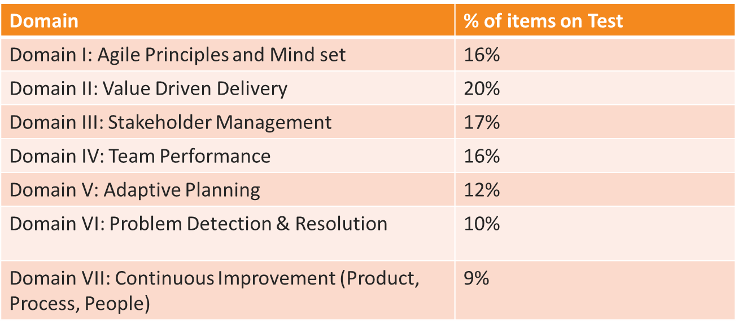
Question Distribution

Slide 17
Common Mistakes
For caselets/situation based questions, analyze the problem in the context of the question instead of your experience.
Example:
Which of the following are the responsibilities of the Scrum Master?
a. Achieving initial and ongoing funding for the project
b. Teaching the Product Owner how to maximize ROI and the objectives
c. Being responsible for developing the functionality of the product
d. Removing the barriers between the customer and the Product Owner

Slide 18
Important Links
The PMI-ACP homepage, https://www.pmi.org/certification/agile-management-acp.aspx
Check out the download-able PDF handbook, exam guide and reference list.

Slide 19
Thank You
Questions/Queries/Feedback
Recording and presentation will be made available to you within 24 hours

